Slide 1
Eclipse Plug-in Development
Eclipse Plug-in Development Part 1
Views

Slide 2
Contents
How to create a view?
How to contribute actions?
Context menu
Local toolbar
Local menu

Slide 3
Creating View
org.eclipse.ui.views
category
e4view
view
stickyView
<extension
point="org.eclipse.ui.views">
<category
name="Ecsoya"
id="org.ecsoya.eclipse.tutorial.views">
</category>
<view
name="Sample View"
icon="icons/sample.gif"
category="org.ecsoya.eclipse.tutorial.views"
class="org.ecsoya.eclipse.tutorial.views.views.SampleView"
id="org.ecsoya.eclipse.tutorial.views.views.SampleView">
</view>
</extension>

Slide 4
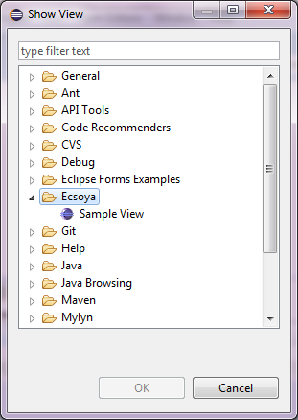
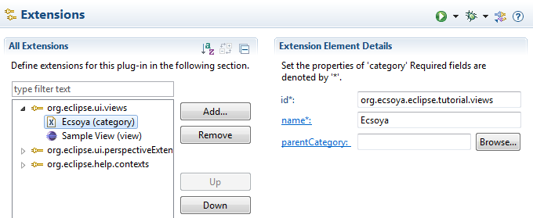
Creating View
Category

Slide 5
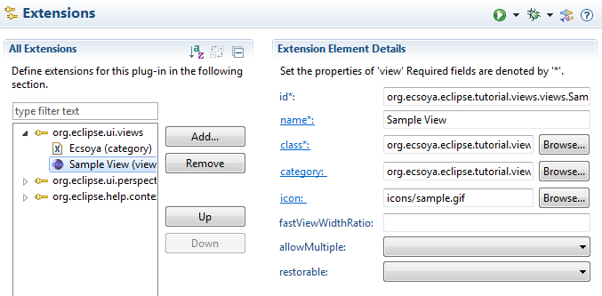
Creating View
View

Slide 6
Creating View
IViewPart and ViewPart
public class SampleView extends ViewPart {
public void createPartControl(Composite parent) {
}
public void setFocus() {
}
}

Slide 7
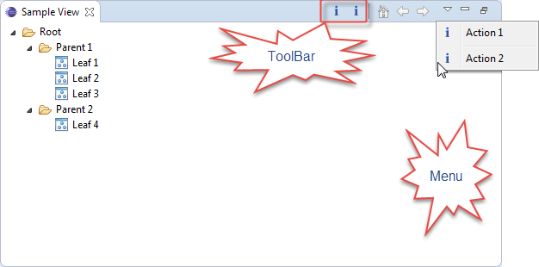
Contributing Actions

Slide 8
Contributing Actions
Context Menu
MenuManager menuMgr = new MenuManager("#PopupMenu");
menuMgr.setRemoveAllWhenShown(true);
menuMgr.addMenuListener(new IMenuListener() {
public void menuAboutToShow(IMenuManager manager) {
SampleView.this.fillContextMenu(manager);
}
});
Menu menu = menuMgr.createContextMenu(viewer.getControl());
viewer.getControl().setMenu(menu);
getSite().registerContextMenu(menuMgr, viewer);

Slide 9
Contributing Actions
Local ToolBar
IActionBars bars = getViewSite().getActionBars();
IToolBarManager manager = bars.getToolBarManager();
manager.add(action1);
manager.add(action2);

Slide 10
Contributing Actions
Local Menu
IActionBars bars = getViewSite().getActionBars();
IMenuManager manager = bars.getMenuManager();
manager.add(action1);
manager.add(new Separator());
manager.add(action2);

Slide 11
Any Questions?
Skype: jin.liu.soyatec
Email: jin.liu@soyatec.com

Slide 12
The end

